Slide 1
Welcome Delegation 2019!
You‘ve made it.

Slide 2
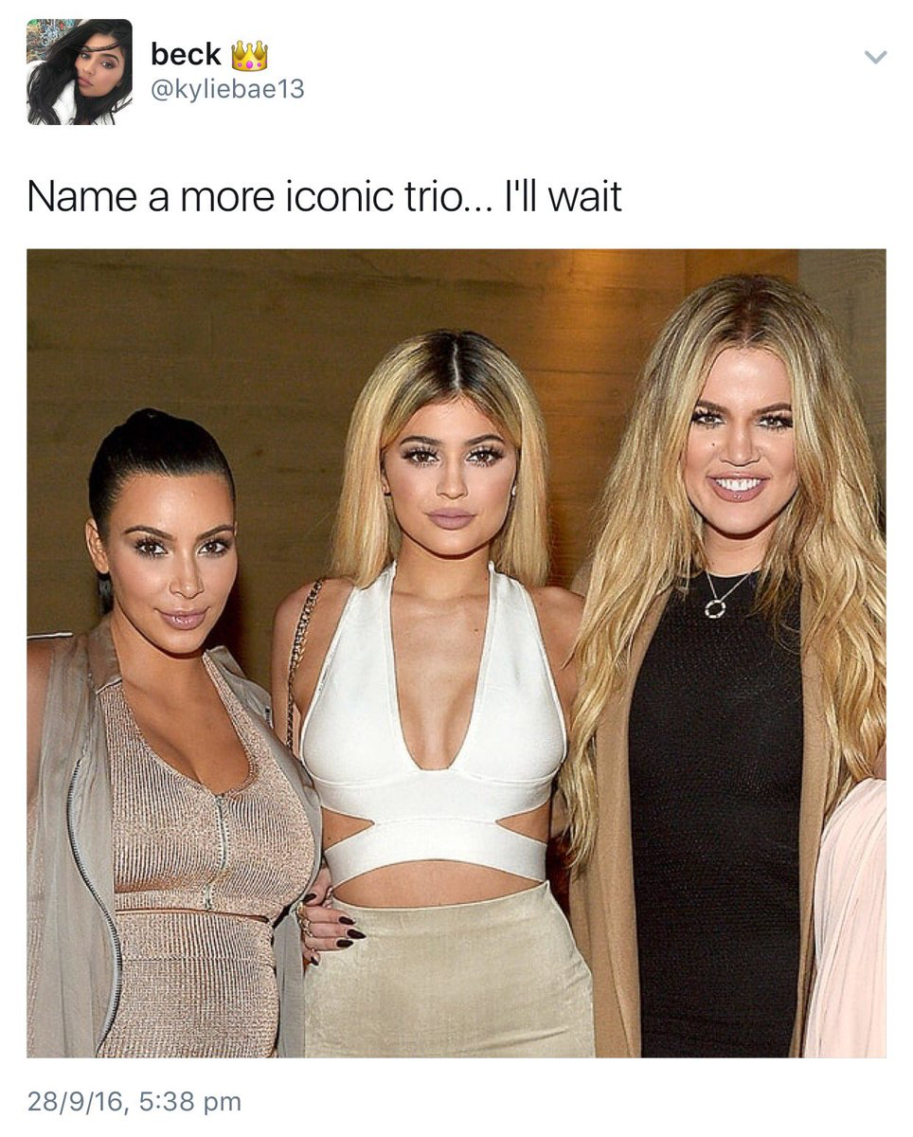
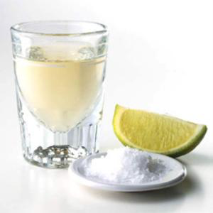
WHO WE ARE
Martin de Wall
Luisa Entenmann
Alia Baltabey
....
Just kidding:

Slide 3
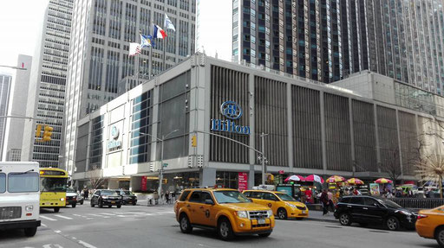
KEY INFORMATION
When is the conference?
→ 14 – 18 April 2019 (but keep in mind that the study program will take place earlier, most likely 7 April 2019)
A fee will be charged soon. Be prepared to do the payment.
We expect your attendance (no excuses!). Latecomers will be on cake duty!
There will be two MUNs in (1) Hohenheim and (2) Tübingen (date to be confirmed).

Slide 4
ABOUT NMUN
The Mission
National Model United Nations (NMUN) is a U.S. 501(c)(3) nonprofit organization that advances understanding of the United Nations and contemporary international issues. We positively affect the lives of participants and prepare them to be better global citizens through quality educational experiences that emphasize collaboration and cooperative resolution of conflict. We envision a world comprised of civically engaged people who strive for peaceful, multilateral conflict resolution and equitable, sustainable human development.

Slide 5
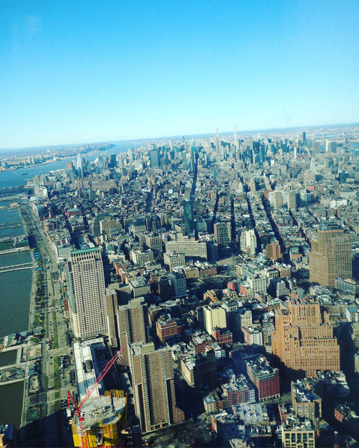
ABOUT NMUN
With participants from:
138 Member States
50 US States
411 Colleges & Universities
Engaging over 6,904 Global Citizens
6,239 Student Delegates
457 Faculty
208+ Volunteers
Global Diversity (59% international)

Slide 6
WHAT YOU‘LL NEED TO DO
In case of sickness please write us an email that you cannot attend next session. (We will not accept unexcused absences!)
Be prepared to pay the NMUN charge soon.
Think of people who might be suitable sponsors and remember it will benefit YOU since sponsoring is going to reduce the costs.
In case you do not have any appropriate business clothes go shopping.
HOMEWORK: Have a look at the Rules of Procedures (short version) and memorise them!
HOMEWORK: Print out the membership application (on our website) and fill it out.
HOMEWORK: Like our Instagram and Facebook-Profile! (@heidelberglawnmun)

Slide 7
PASSWORD
On our website (www.heidelberg-law-nmun.org):
„Materialien“ – „Training Sessions“
PW: „NMUNgroupies“

